Slide 1
Neutrality Act 1939 – declares US neutral, establishes “cash and carry” program
Cash and carry – warring nations could buy weapons from the US so long as they paid cash and carried the arms on their own ships
Change!!!!
Lend-Lease Act – the US would be able to lend or lease arms to any country considered “vital to the defense of the US”

Slide 2
Germany Germany Germany
Japan?

Slide 3
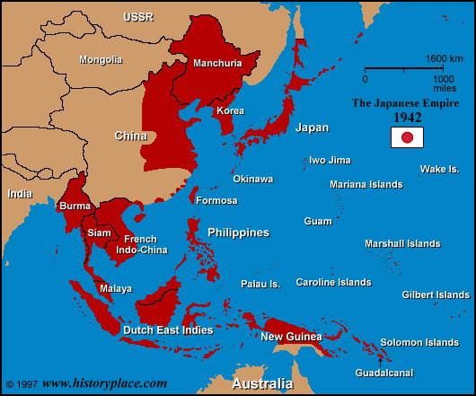
Japan’s been doing some work in the East
Signs non-aggression pact with the USSR
Export Control Act 1940
July - Japan invades Indochina

Slide 4
What happens next in the US?
Fifth Column - any group of people who undermine a larger group—such as a nation or a besieged city—from within.
Theater of Operation - a region in which active military operations are in progress
Internment - the imprisonment or confinement of people

Slide 5
Your job:
Should internment camps be established on the West Coast of the United States?

Slide 6
Internment Camps:
Spring/Summer of 1942, 120,000 Japanese Americans forced to relocate
Nearly 2/3 of them were native-born US citizens
The “worst wartime mistake”? A long history

Slide 8
From 1941 to 1943 Dr. Seuss created more than 400 political cartoons for PM Newspaper in New York—tackling such subjects as
racial discrimination,
the dangers of isolationism,
social injustice and anti-Semitism,
political machinations,
the war effort,
political leadership

Slide 9
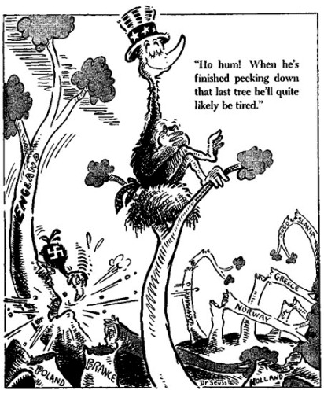

Slide 10
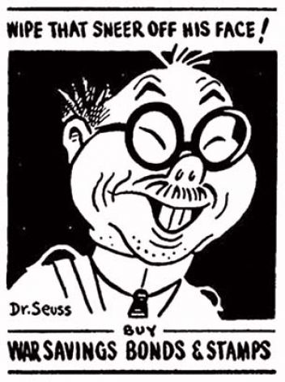

Slide 11
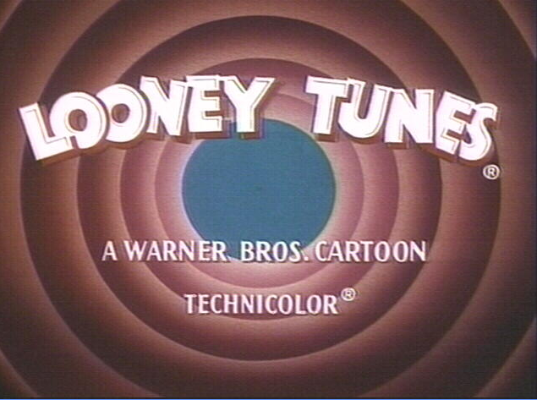
https://www.youtube.com/watch?v=ic5XjnG3foY

Slide 12
Gearing up for war:
War production board (WPB) – organization that has the authority to set priorities and production goals & control the distribution of raw materials
Example of centralized govt.
Selective Service and Training Act – first peacetime draft, implemented after Germany defeated France
https://www.youtube.com/watch?v=vs3pgaMcV3w

Slide 13
War and Production
War production will take the US out of the Great Depression
An industrial war
Private companies are retooled for the war
Ex: Dodge factory starts manufacturing B-29 bomber engines
Pullman company – build tanks

Slide 14
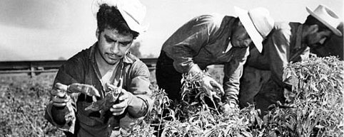
Changes in the labor force
Women in the workforce
Mexican Immigration (Bracero
Program, 1942-1964)

Slide 15
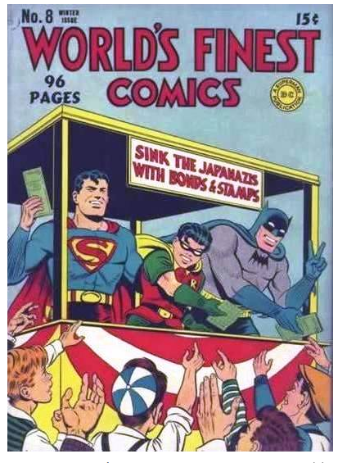
How is the US paying for the War?
Gov’t spends $300 billion
Paid for in part by taxes (only 45%)
War bonds

Slide 16
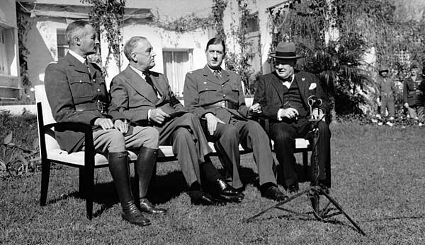
Fighting the war
Allied Powers – US, Britain, France, USSR (and others)
Casablanca Conference (Jan. 14 – 24, 1943)

Slide 17
Some important dates and events
August, 1942: Stalingrad
Turning point of the war
Jan. 1943 – Casablanca
Affirm goal of unconditional surrender of Axis Powers
July – Sept ‘43
Allied forces capture Sicily the “soft underbelly”
Italy surrenders Sept ‘43

Slide 19
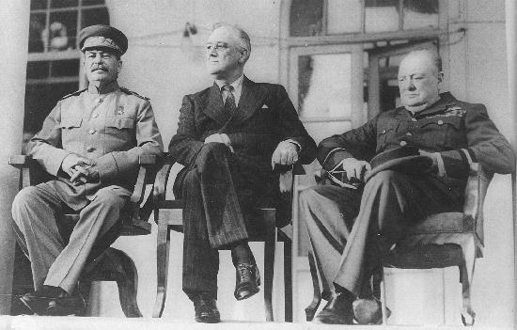
The Meeting of the Big Three Nov. 1943

Slide 20
Meeting of the Big Three
Several promises
Stalin to launch offensive once Allies invade France
FDR and Stalin agree to break up Germany
USSR will help US beat Japan after they deal with Germany
Agree to a new international organization for world peace after the war

Slide 21
Operation Overlord
The code name for the plan for invading Northern France
Need to right conditions
D-Day – June 6, ‘44 – the invasion of France
August, 1944 - the Allies liberate Paris
https://www.youtube.com/watch?v=n9Zz7sgOF0A
https://www.youtube.com/watch?v=QzgKMDydr5Y

Slide 22
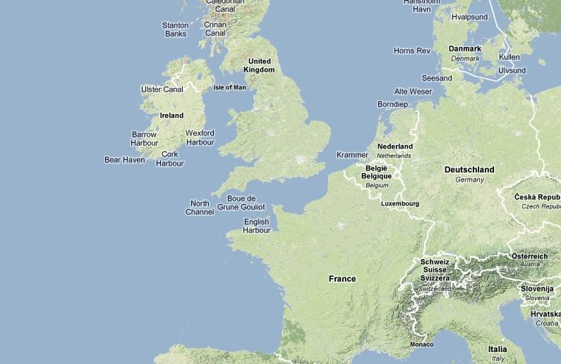

Slide 23
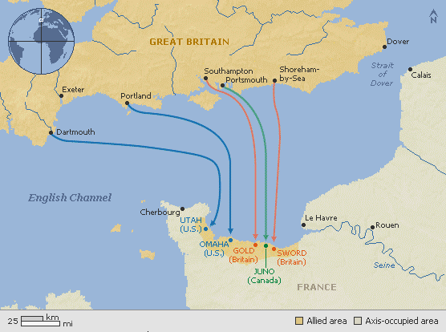

Slide 24
Operation Overlord
The code name for the plan for invading Northern France
Need to right conditions
D-Day – June 6, ‘44 – the invasion of France
August, 1944 - the Allies liberate Paris
https://www.youtube.com/watch?v=n9Zz7sgOF0A
https://www.youtube.com/watch?v=QzgKMDydr5Y

Slide 25
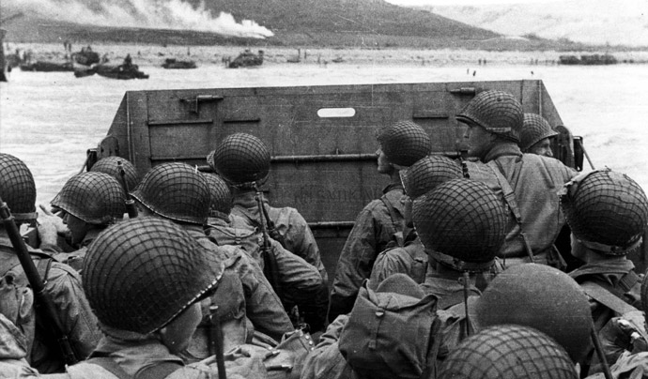

Slide 26
